Slide 1
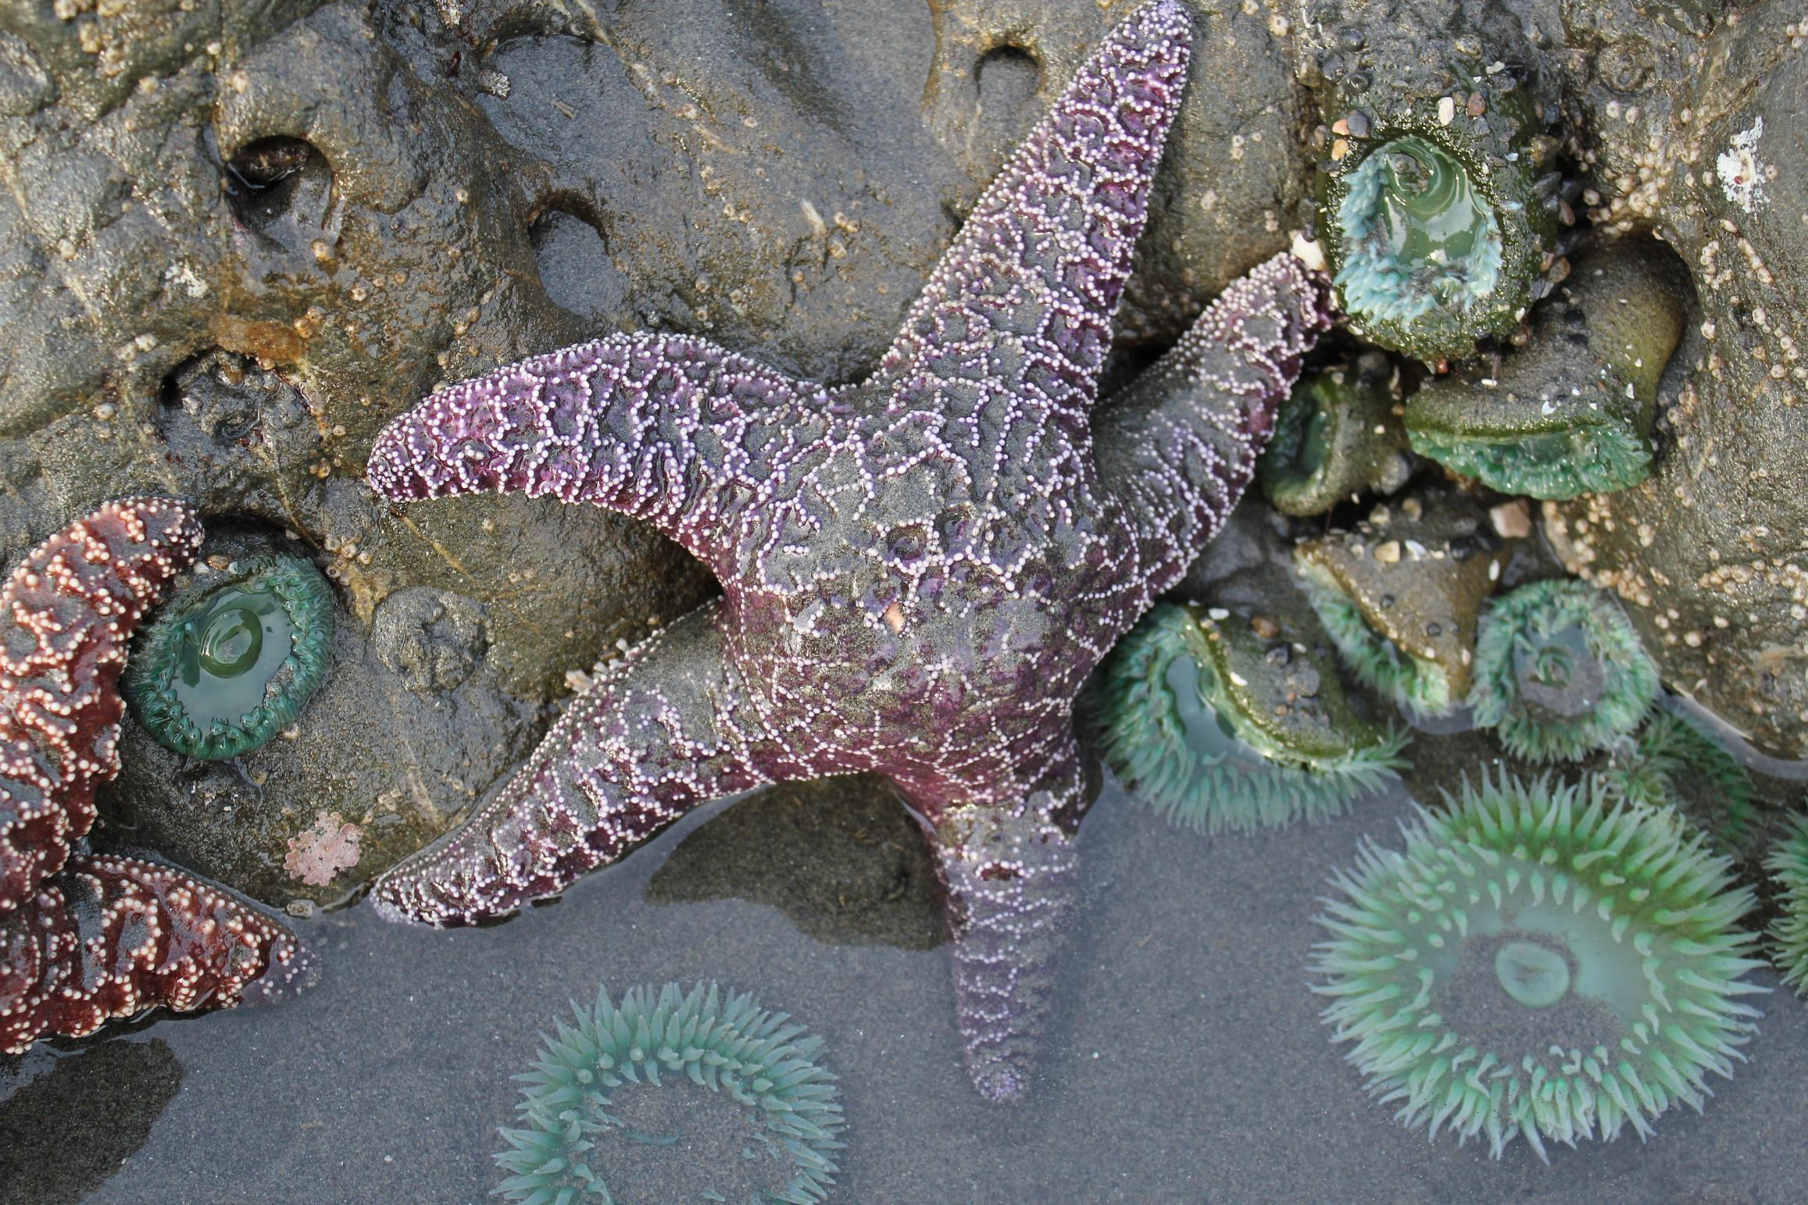
Tide Pool Biodiversity
Notes:
Good afternoon class! Today let’s take an adventure to the rocky shore and learn about tide pool biodiversity!

Slide 2
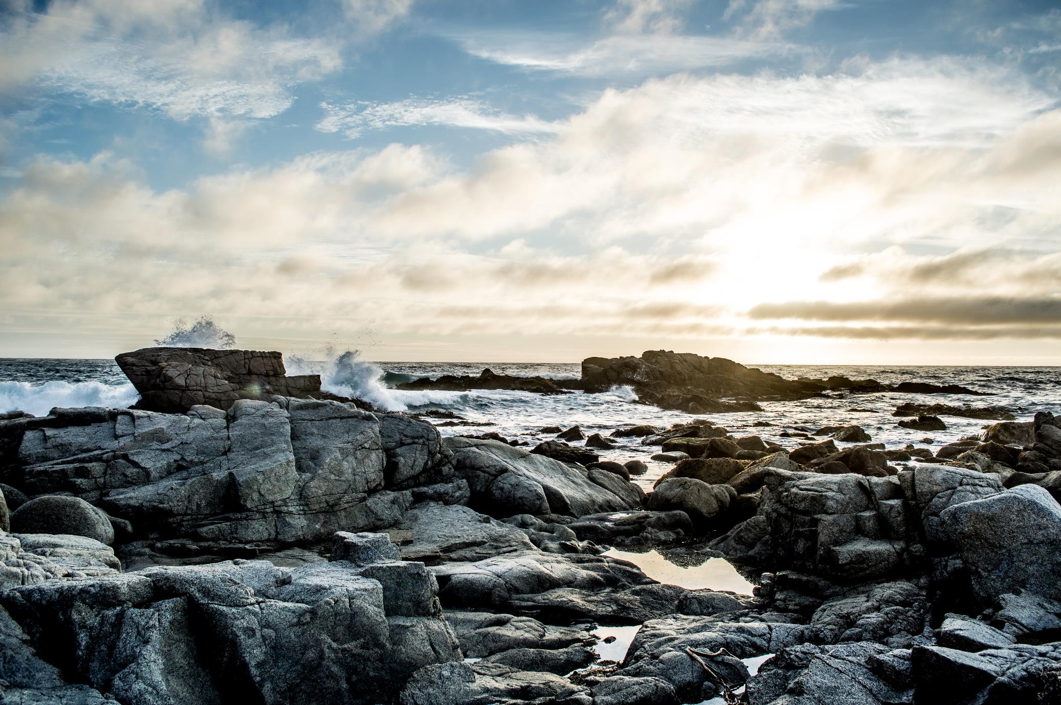
Have you ever been to the ocean before?
Have you watched the tides go in and out?
Notes:
-Good opportunity to see if students know anything about the tides/what the tides are
-Tides happen every day, water is low for a while then high for a while

Slide 3
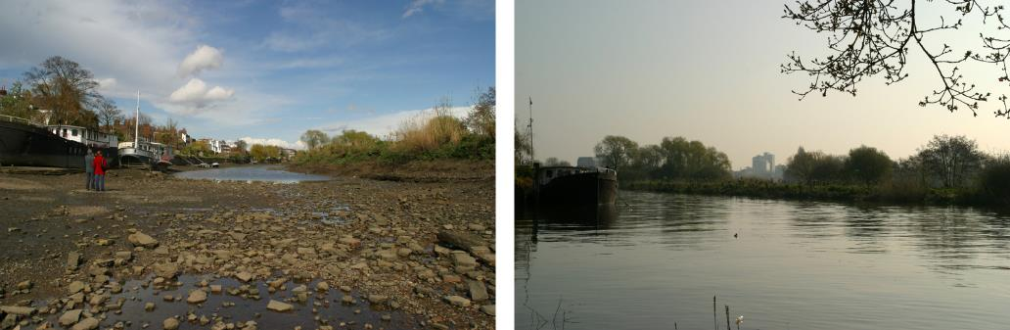
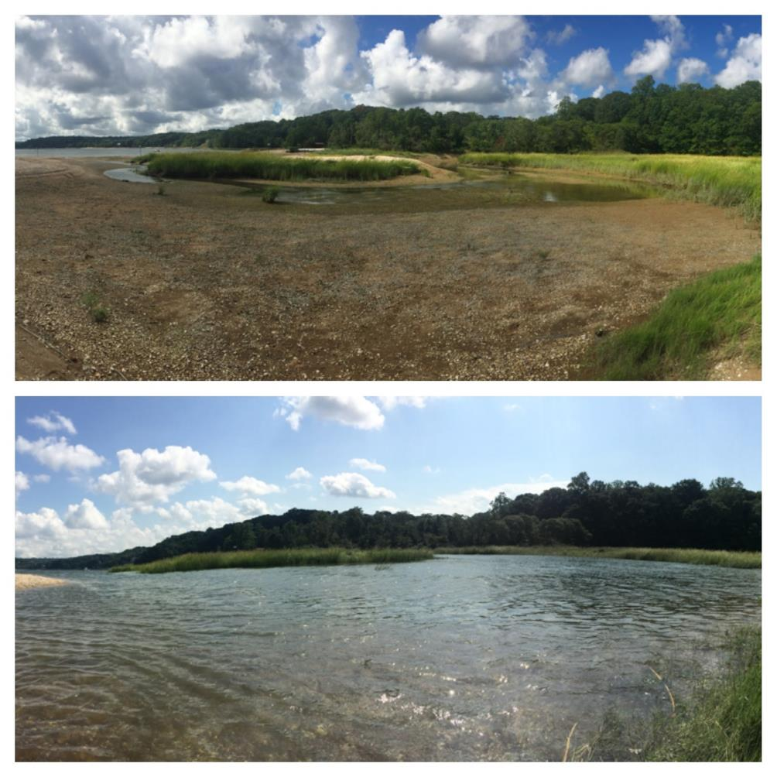
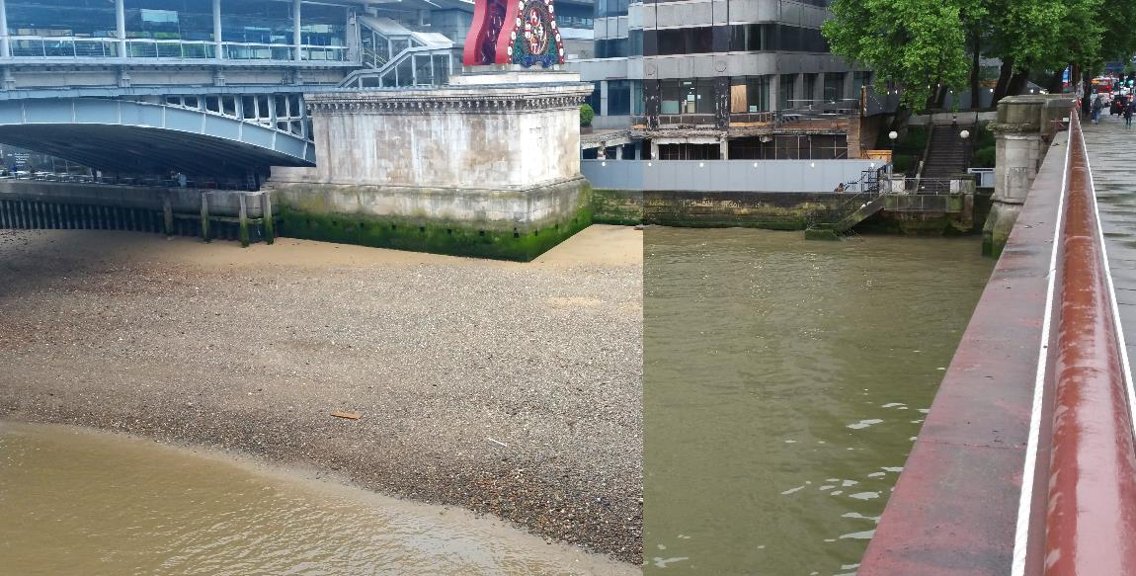
Tides come in… tides go out
Pointillist at English Wikipedia, CC BY-SA 3.0 <https://creativecommons.org/licenses/by-sa/3.0>, via Wikimedia Commons
Wing, CC BY-SA 4.0 <https://creativecommons.org/licenses/by-sa/4.0>, via Wikimedia Commons
Erica Brown, NPS Photo, Northeast Coatsal & Barrier Network Flickr, CC BY-SA 2.0
Notes:
These are images of coastal areas at high and low tides – notice how much the water level changes. Might be hard to figure out the best place to put your beach towel.

Slide 4
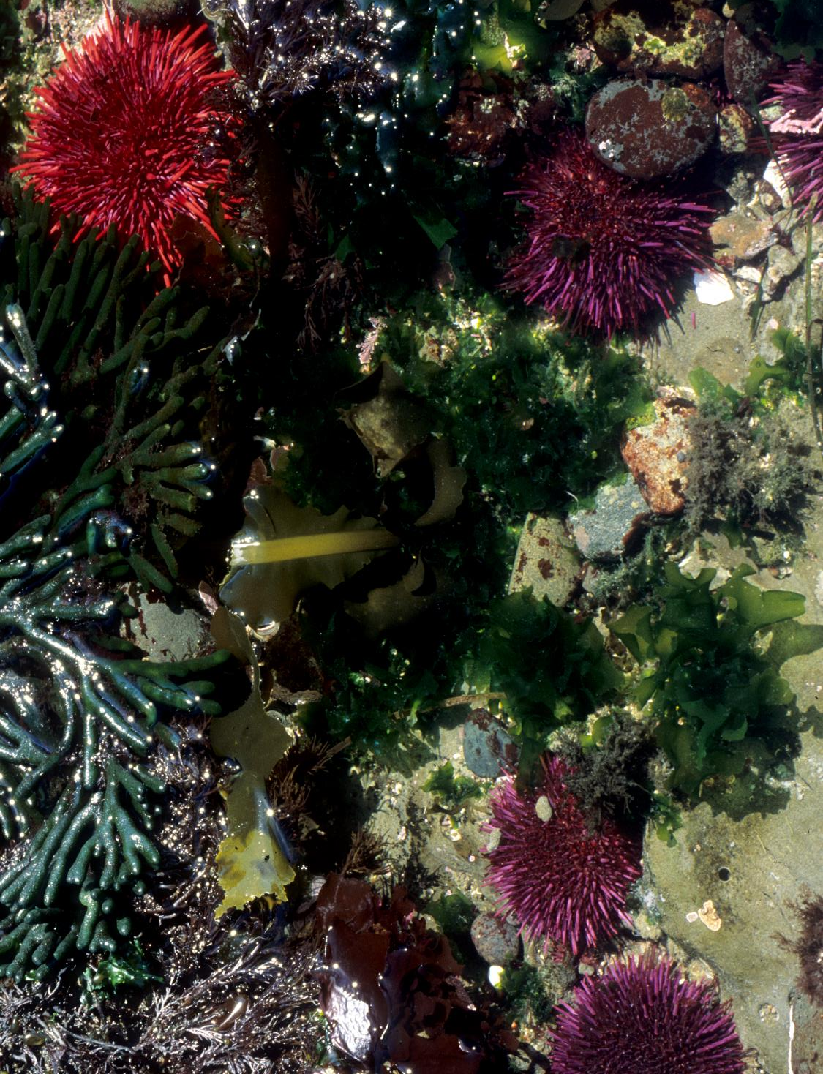
What happens to the animals that live on the beach?
Notes:
Where should I go if I always want to stay wet? If I always want to stay dry? If I want to eat the dry/wet things?

Slide 5
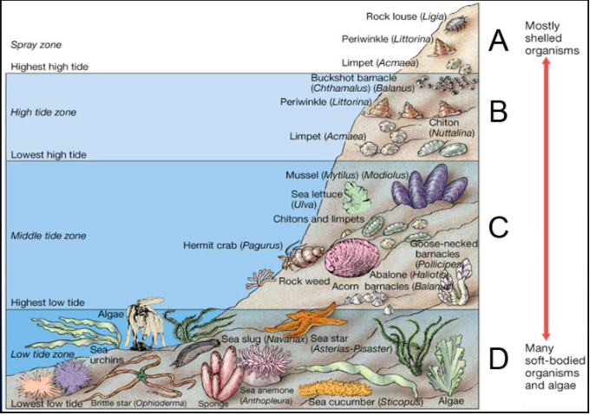
Who Lives At the Ocean Shore?
From: https://healthebay.org/wp-content/uploads/2020/04/Living-on-the-Edge-Field-Guide-to-Rocky-Intertidal.pdf
Notes:
Talk about how much time animals in each zone spend submerged – notice anything about the animals in the upper zone? (shells)

Slide 6
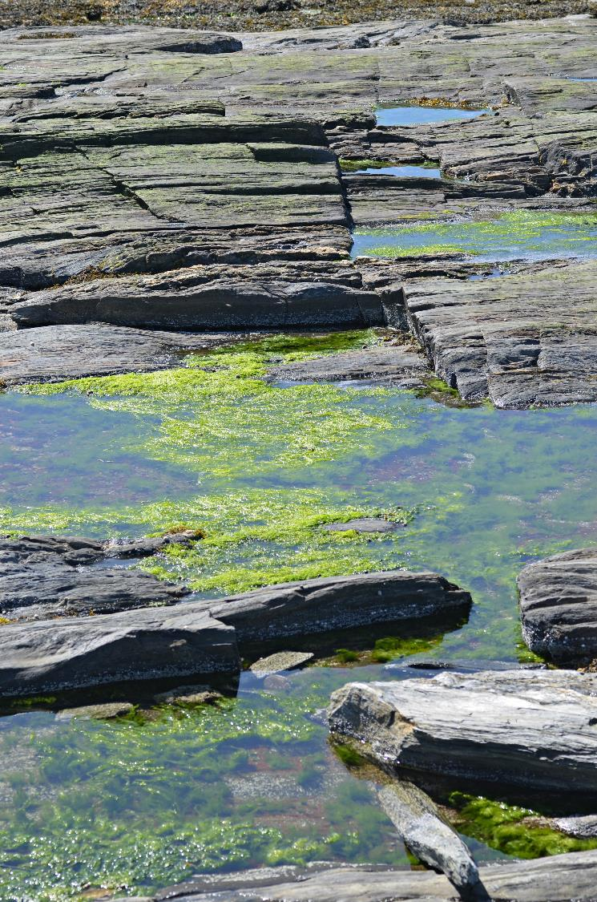
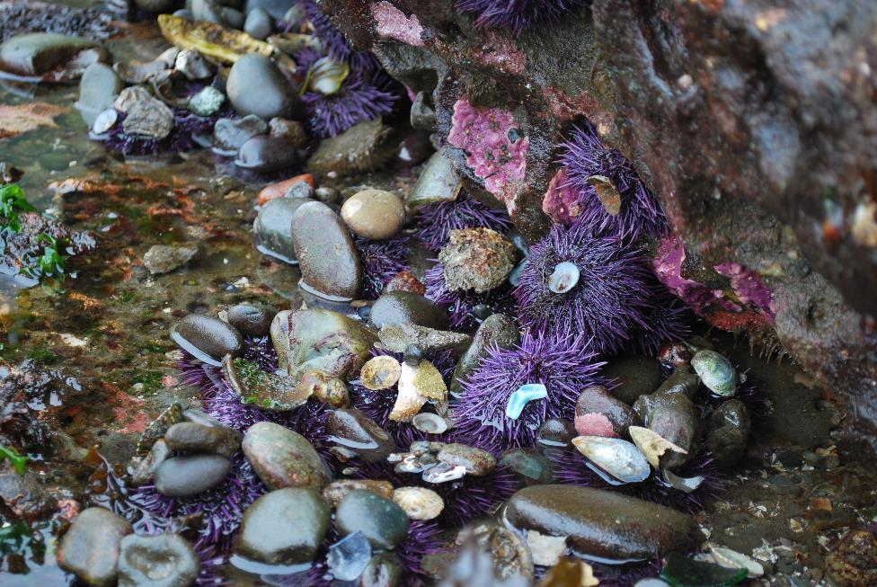
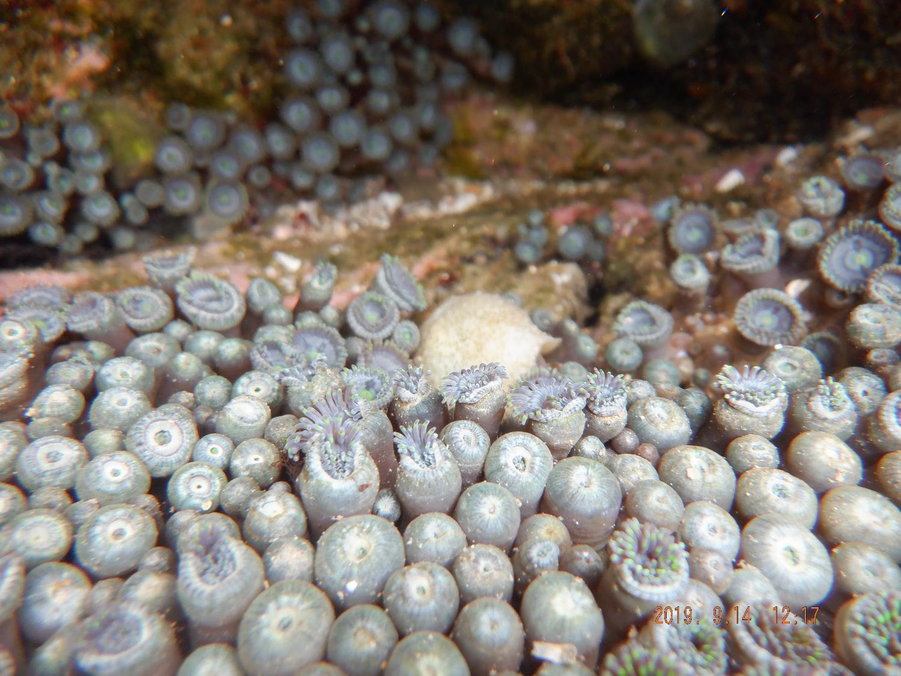
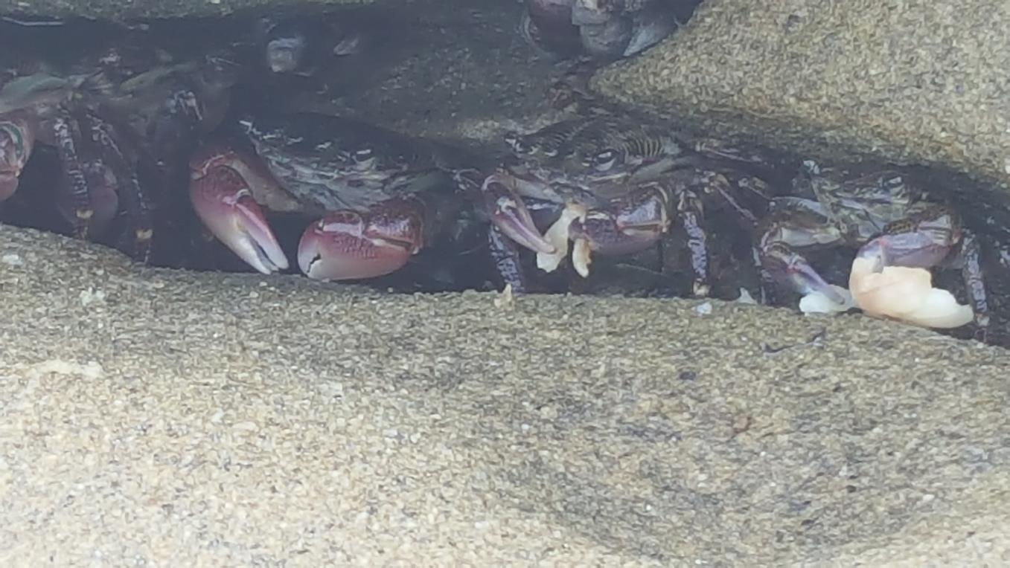
Now let’s start our activities!
Photo by and (c)2014 Derek Ramsey (Ram-Man), CC BY-SA 4.0 <https://creativecommons.org/licenses/by-sa/4.0>, via Wikimedia Commons
Kai Medina (Mk170101), CC BY-SA 4.0 <https://creativecommons.org/licenses/by-sa/4.0>, via Wikimedia Commons
Kong of Lasers, CC BY-SA 4.0 <https://creativecommons.org/licenses/by-sa/4.0>, via Wikimedia Commons

Slide 7
Everyone spread out … make sure you have some room
Notes:
If some students are unable to make the movements in the first activity alone now is a good time to have students partner up

Slide 8
We are going to pretend we are animals moving with the tides.
Make sure to not get dried out!
Notes:
If I had a lot of time on my hands I would turn this into a “lava” or tag game, feel free to modify.

Slide 9
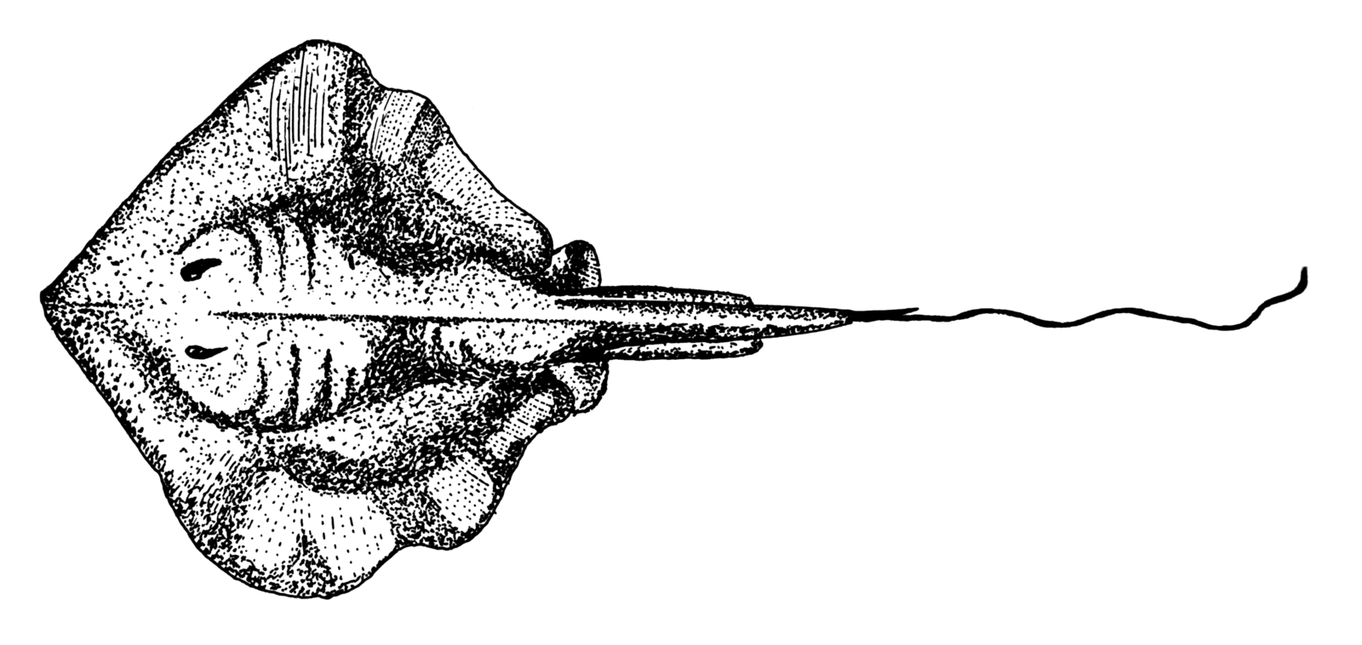
Notes:
What animal is this? A stingray!

Slide 10
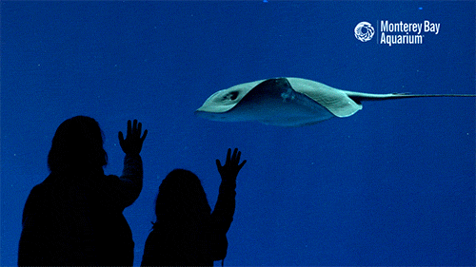

Slide 11
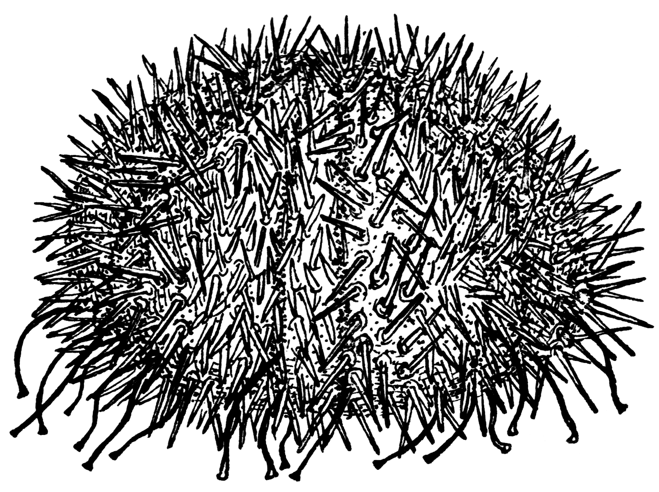
Notes:
What animal is this? A sea urchin
(see if students know how sea urchins move – they have hundreds of tine “tube feet”)

Slide 12
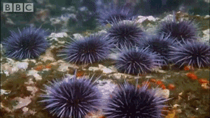

Slide 13
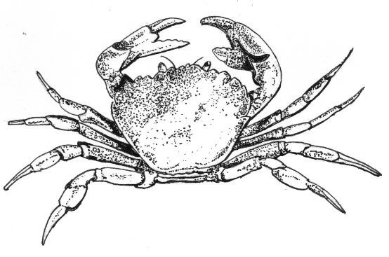
Notes:
It’s a crab!

Slide 14
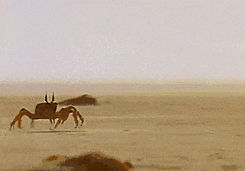

Slide 15
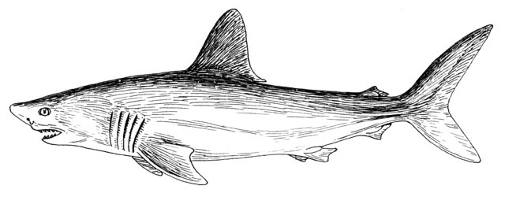
Notes:
A shark! (I apologize in advance for the baby-shark singing, feel free to remove slide)

Slide 16
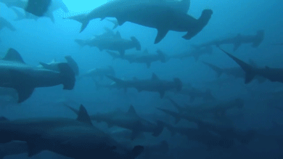

Slide 17
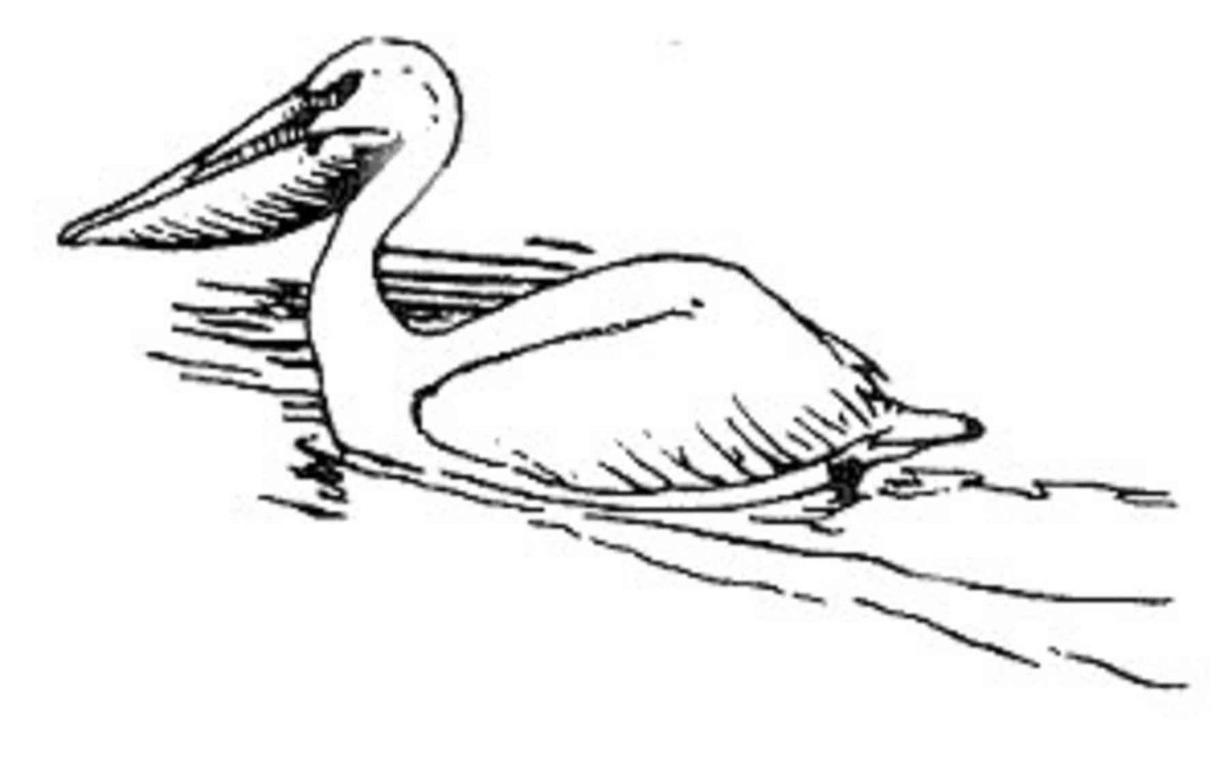
Notes:
A pelican!
Pelicans fly in a really cool way where they glide low over the water and then scoop up fish (gif on next slide) – so no flapping!

Slide 18
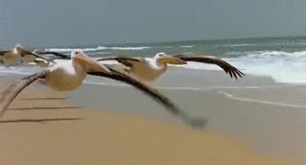

Slide 19
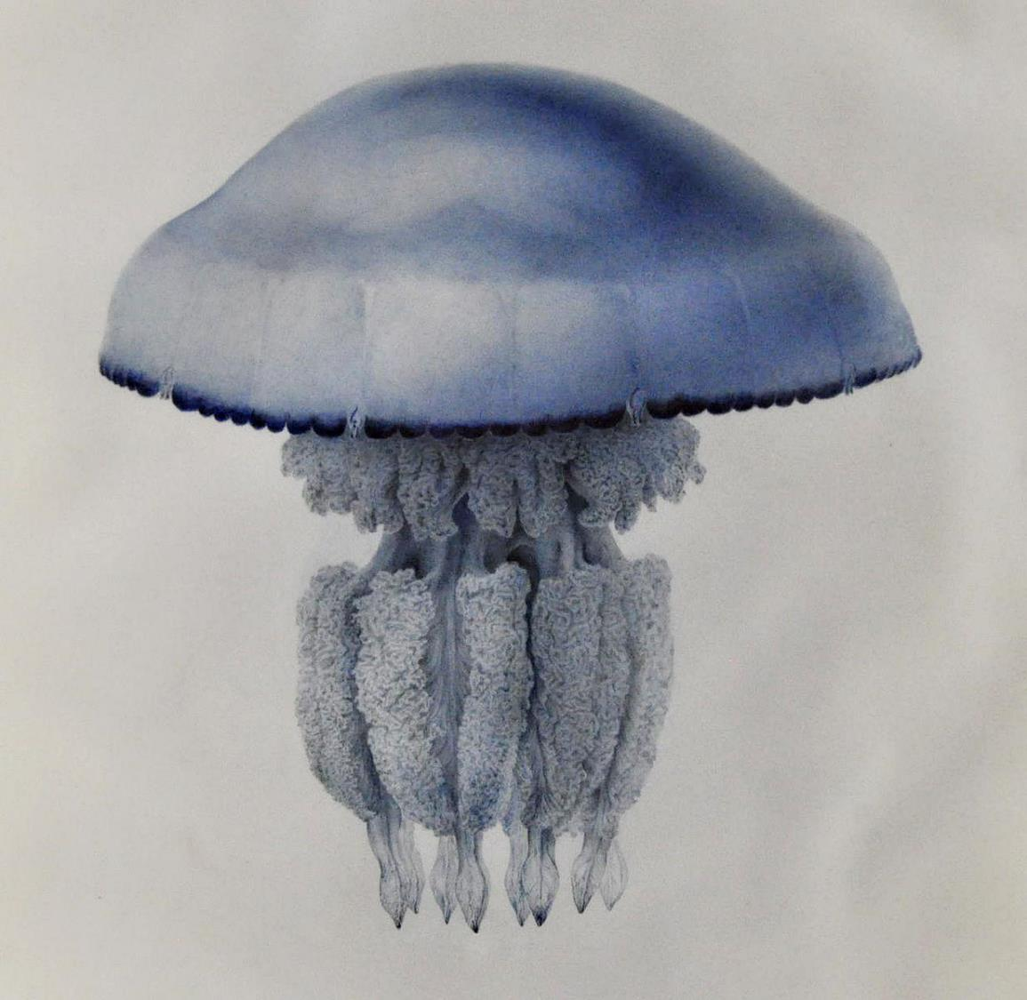
Notes:
A jellyfish!

Slide 20
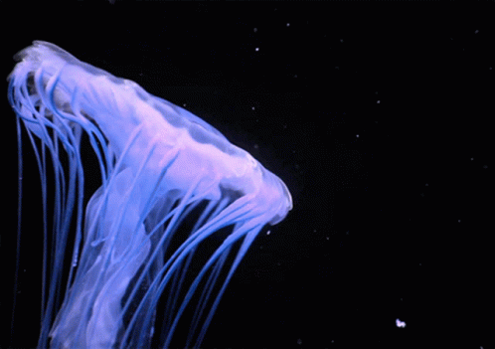

Slide 21
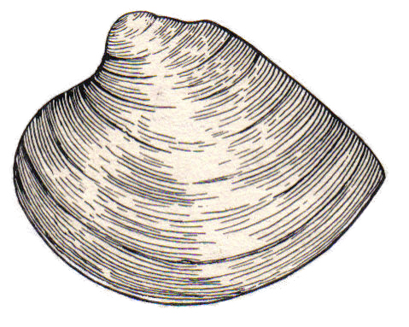
Notes:
A clam!
Students may not be familiar with how clams burrow – it is super weird (next slide). Look up videos of geoducks if they think it’s cool.

Slide 22
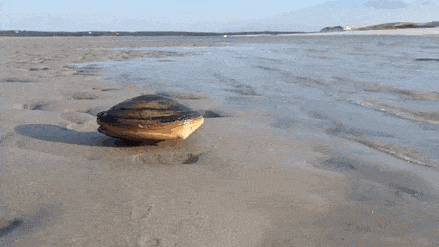
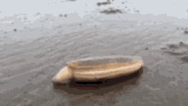

Slide 23
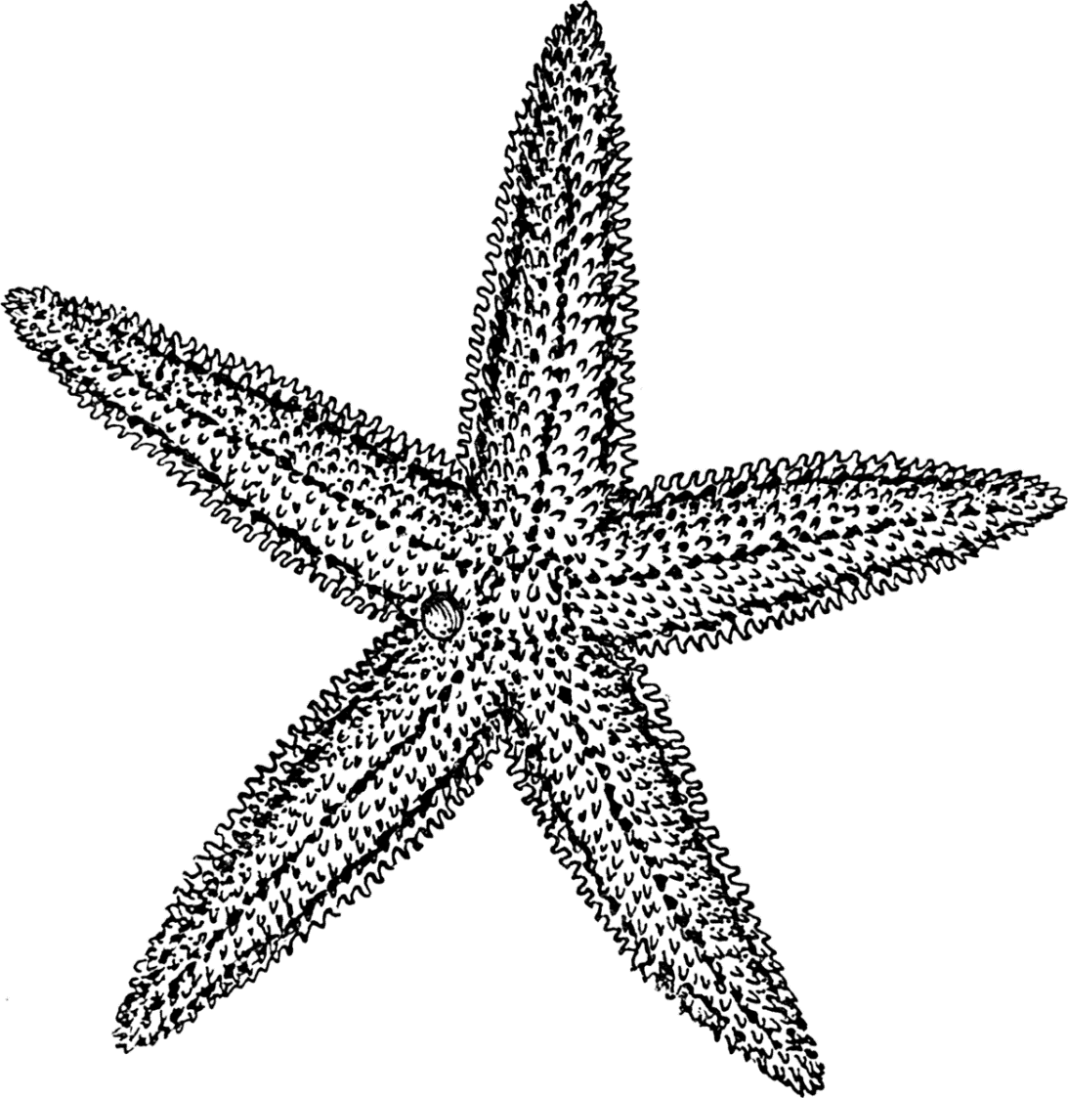
Notes:
A starfish!
I bet these guys move differently than most students thought. They are actually related to sea urchins, and move more or less in the same way (hundreds of tube feet).

Slide 24
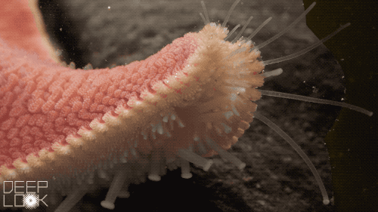
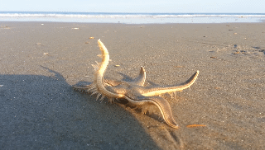

Slide 25
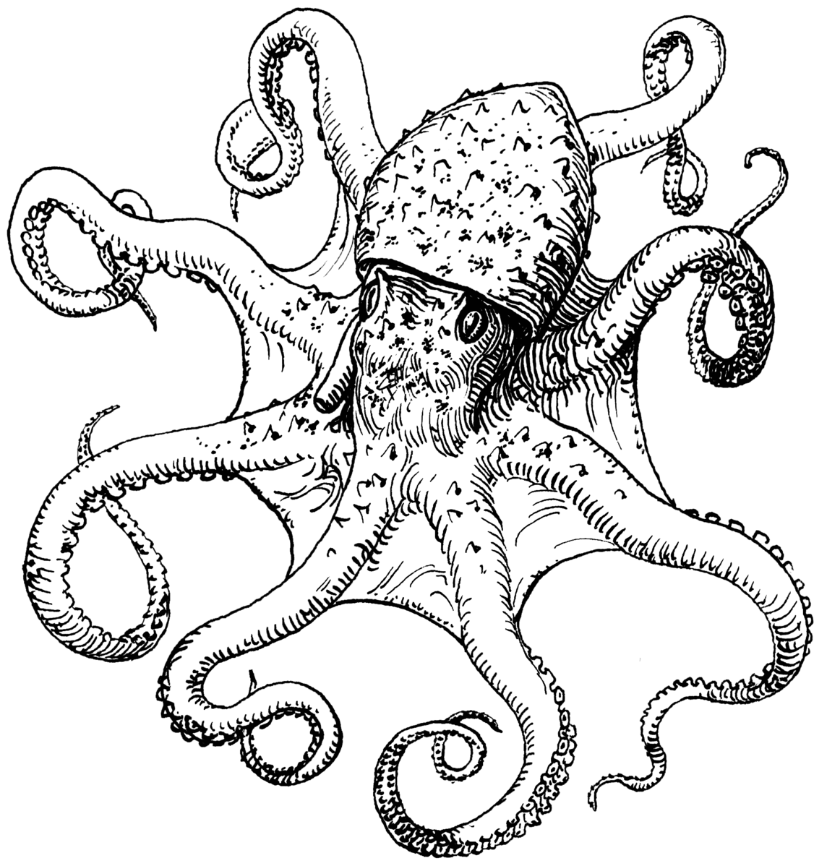
Notes:
An octopus!

Slide 26
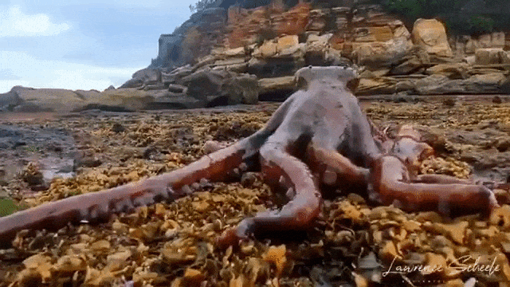
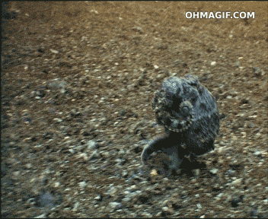

Slide 27
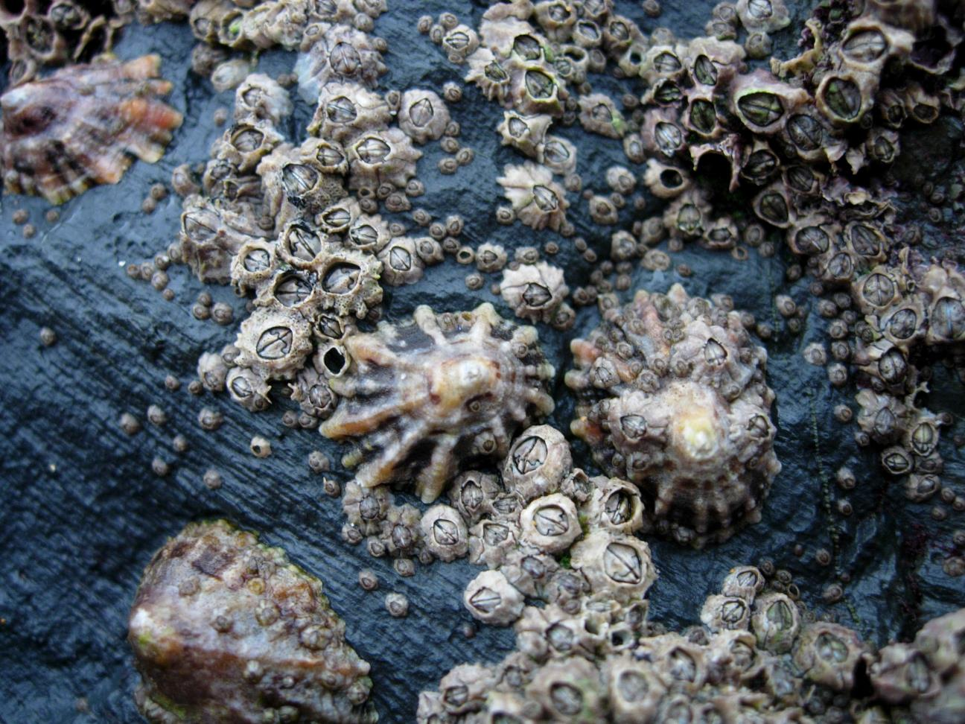
Notes:
Barnacles! These guys like to grow on rocks and boat hulls.
Can talk about filter feeding using the next slide if you want.

Slide 28
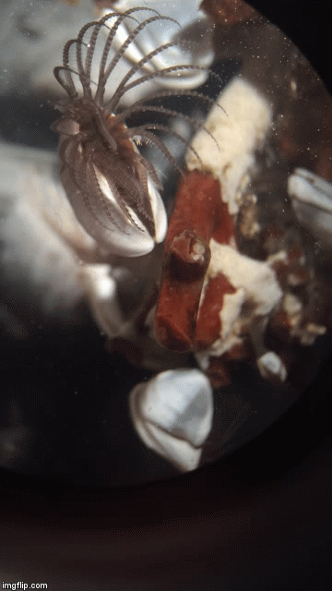
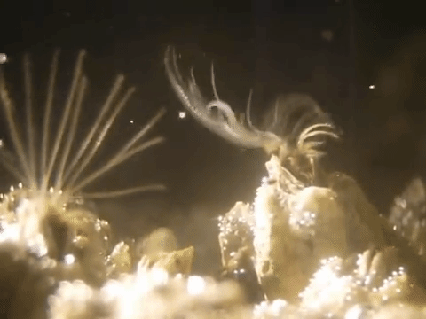
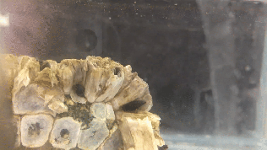
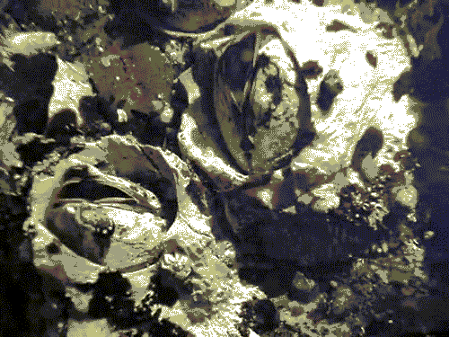
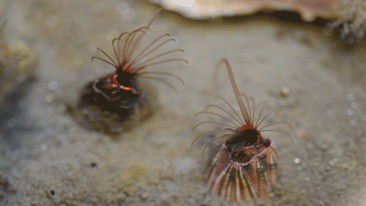

Slide 29
Do animals have any special body parts that help them move?
Can all animals that live on or near the shore swim?
Notes:
Use the examples you’ve seen so far (fins, legs, a “foot” in the case of the clam, tube feet, etc). Hopefully a resounding “no” for the second one.

Slide 30
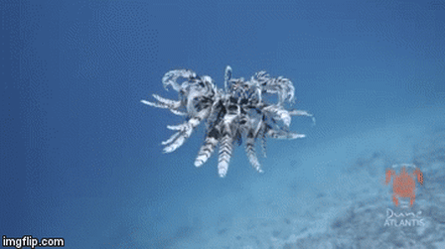
Notes:
This is a feather star (related to starfish and sea urchins) – they are super weird (they usually just sit and filter feed but this is how they move when they need to)

